Slide 1
EDUC 200C
Section 3
October 12, 2012

Slide 2
Goals
Review correlation prediction formula
Calculate z_{y}’ = r_{xy}z_{x} for a new data set
Use formula to predict a student’s score
Talk more about regression
Import data set into Stata
Use Stata to come up with regression formula and use that to predict a student’s score
Scatterplot in Stata
Introduce concept of Standard Error

Slide 3
Correlation prediction formula
z_{y}’ = r_{xy}z_{x}
Simple formula
Easy to use
But must use z-scores

Slide 4
High School and Beyond data
(Data found in Coursework)
Open data, look at it, get a sense about it.
Choose two variables (let’s do RDG and MATH)
Scatterplot
Calculate z-scores
Calculate r
Write prediction formula
Use the formula to predict one z-score, given another.

Slide 5
Regression
In regression, you don’t need z-scores. You can remain in your original data.
Use to predict how one variable changes in response to another variable.
In the high school and beyond data, we examine what we might expect a student’s math score to be given that we know the student’s reading score.
Computers and mathematical formulas help us calculate a regression formula.

Slide 6
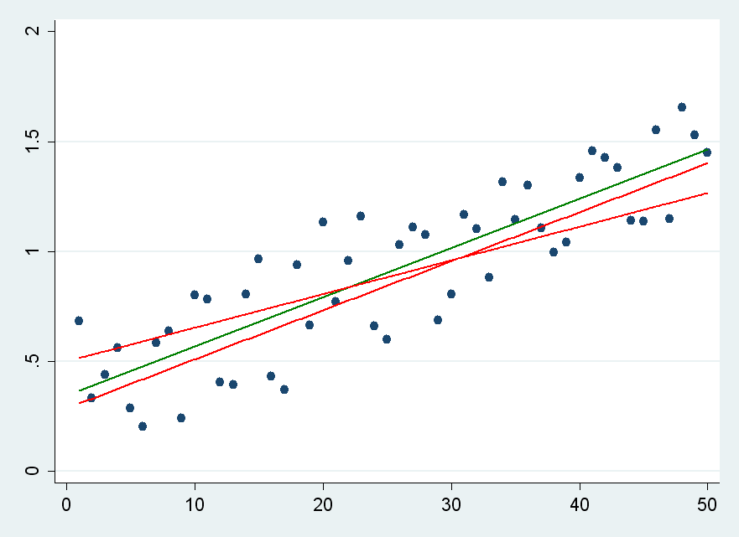
We calculate regression lines by minimizing the total squared difference between the line representing our prediction and the actual data.

Slide 7
Do you remember y = mx+b?
This is the slope-intercept equation for line.
m is slope
b is y-intercept
The regression line is given in this format. We’re given the slope of the line and the y-intercept.
Y’ = b_{YX}X + a_{YX}
What does each part mean?

Slide 8
A little Stata…
. Reg Y X
Source | SS df MS Number of obs = 50
-------------+------------------------------ F( 1, 48) = 4312.81
Model | 3.92107903 1 3.92107903 Prob > F = 0.0000
Residual | .043640216 48 .000909171 R-squared = 0.9890
-------------+------------------------------ Adj R-squared = 0.9888
Total | 3.96471925 49 .080912638 Root MSE = .03015
------------------------------------------------------------------------------
Y | Coef. Std. Err. t P>|t| [95% Conf. Interval]
-------------+----------------------------------------------------------------
X | .0194055 .0002955 65.67 0.000 .0188114 .0199996
_cons | .0418653 .008658 4.84 0.000 .0244573 .0592733
------------------------------------------------------------------------------

Slide 9
A little Stata…
. Reg Y X
Source | SS df MS Number of obs = 50
-------------+------------------------------ F( 1, 48) = 4312.81
Model | 3.92107903 1 3.92107903 Prob > F = 0.0000
Residual | .043640216 48 .000909171 R-squared = 0.9890
-------------+------------------------------ Adj R-squared = 0.9888
Total | 3.96471925 49 .080912638 Root MSE = .03015
------------------------------------------------------------------------------
Y | Coef. Std. Err. t P>|t| [95% Conf. Interval]
-------------+----------------------------------------------------------------
X | .0194055 .0002955 65.67 0.000 .0188114 .0199996
_cons | .0418653 .008658 4.84 0.000 .0244573 .0592733
------------------------------------------------------------------------------
Regression slope
Regression intercept

Slide 10
Regression line notation and formulas
Y’ = b_{YX}X + a_{YX}
Regression line slope: b_{YX} = r_{YX} (σ_{y} / σ_{x})
Regression line intercept: a_{YX} = Y - b_{YX}X

Slide 11
Stata activity
Import High School and Beyond data into Stata
For fun, run correlation on Reading and Math:
Corr rdg math (Isn’t it so much easier in Stata!?!)
Run regression: Regress math rdg
Write out regression line and interpret what it means.
Create Scatterplot:
graph twoway (scatter math rdg) (lfit math rdg)

Slide 12
How do we know if we’ve explained the data well?
We want, for example, average SAT score to tell us a lot about a school’s graduation rate—how do we know if it does?
We look at the standard error.
Standard error is the same as standard deviation except that we look at deviation from the prediction rather than deviation from the mean

Slide 13
How do we interpret standard error?
In all cases, the closer the standard error is to zero, the better our predictions are.
(What is this again? And why do we want it to be small? What units is it in?)

Slide 14
More Stata…
. Reg Y X
Source | SS df MS Number of obs = 50
-------------+------------------------------ F( 1, 48) = 4312.81
Model | 3.92107903 1 3.92107903 Prob > F = 0.0000
Residual | .043640216 48 .000909171 R-squared = 0.9890
-------------+------------------------------ Adj R-squared = 0.9888
Total | 3.96471925 49 .080912638 Root MSE = .03015
------------------------------------------------------------------------------
Y | Coef. Std. Err. t P>|t| [95% Conf. Interval]
-------------+----------------------------------------------------------------
X | .0194055 .0002955 65.67 0.000 .0188114 .0199996
_cons | .0418653 .008658 4.84 0.000 .0244573 .0592733
------------------------------------------------------------------------------
Note that these values have bias corrections that make them more like s than σ
Standard error, s_{Y’}

Slide 15
Questions?

